Slide 1


Elevating Equitable
Value Webinar
September 18, 2024

Slide 2

Welcome
Kim Dancy
Associate Director of Research and Policy
September 18, 2024
Notes:
Kim to introduce self and welcome everyone.
Special thank you to Lauren McLeese, a research analyst here at IHEP. Lauren has been instrumental in supporting the development of this research, from reviewing and weighing in on research proposals, supporting logistics and communication with paper authors, and providing feedback on research drafts. She couldn’t be here today, but we deeply appreciate her efforts in making this work possible.

Slide 3
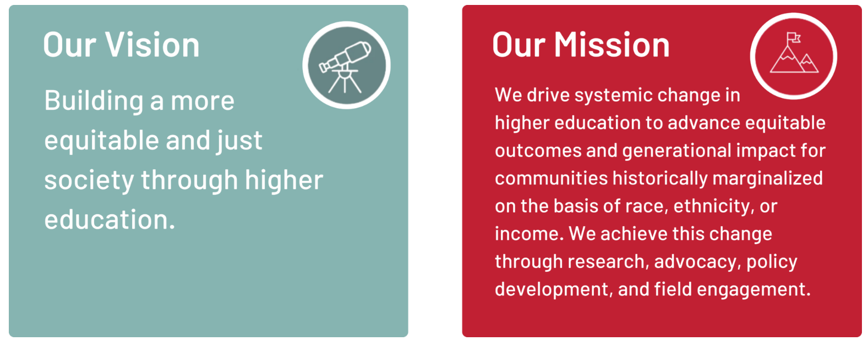
Who is IHEP?
Notes:
The Institute for Higher Education Policy (IHEP) is a nonpartisan, nonprofit, research and advocacy organization focused on building a more equitable and just society through the power of higher education by driving system change to advance equitable outcomes and generational impact for communities that have been historically marginalized.
IHEP also managed the Postsecondary Value Commission, a diverse group of
brought together institutional leaders, the business community, researchers, advocates, students, and more, with a shared goal deepening the field’s understanding and measurement of value.
The Commission set out to explore a big question: what’s the return on investment in postsecondary education?

Slide 4


Postsecondary Value Definition
Photo credit: iStock
Students experience postsecondary value when provided equitable access and support to complete quality, affordable credentials that offer economic mobility and prepare them to advance racial and economic justice in our society.
Notes:
The first step to measuring value is to ensure that we are all working from a shared, nuanced definition of exactly what value in postsecondary education means.
That’s because “Value” is a term that’s widely used but not widely understood—the term can be vague and often has different connotations in different contexts.
We carefully crafted a clear and concise definition to get the field on the same page: Students experience postsecondary value when provided equitable access and support to complete quality, affordable credentials that offer economic mobility and prepare them to advance racial and economic justice in our society.

Slide 5
Measuring Economic Returns
0 | Minimum Economic Return: A student meets this threshold if they earn at least as much as a high school graduate plus enough to recoup their total net price within ten years.
1 | Earnings Premium: A student meets this threshold if they reach at least the median earnings in their field of study, which accounts for expected variations in pay across fields.
2 | Earnings Parity: Informed by the University of Texas System’s research on in-field pay inequities, this threshold measures whether students of color, students from low-income backgrounds, and women meet the median earnings of their more advantaged peers (White students, high-income students, or men).
3 | Economic Mobility: Informed by Opportunity Insights’ measurement of economic mobility across institutions, this threshold measures whether students earn enough to enter the fourth (upper middle) income quintile regardless of field of study.
4 | Economic Security*: While sufficient earnings can create a stable life, wealth is key to building the type of security needed to withstand life’s financial shocks, so this threshold measures whether students reach median levels of wealth.
5 | Wealth Parity*: Mirroring the earnings parity threshold, this threshold measures whether students of color, students from low-income backgrounds, and women reach the level of wealth attained by their more privileged White, high-income, or male peers.
Note: Thresholds 0-3 can be estimated at the national level using College Scorecard data with some caveats. Institutions and systems with advanced data collections can measure these thresholds with greater specificity. Due to a lack of quality data to measure wealth, Thresholds 4 and 5 are currently understood as conceptual goals rather than operable analyses.
Notes:
Working from this shared definition, the Commission developed a series of thresholds to measure the economic returns in higher education.

Slide 6

Notes:
Host (Lauren B) to drop EVE link into chat: https://equity.postseondaryvalue.org/datatool
Kim: The Equitable Value Explorer is an interactive data visualization tool that allows users to compare post-college student earnings outcomes at over 4,000 colleges and universities across the country, disaggregated by key characteristics such as race, gender, and income.

Slide 7
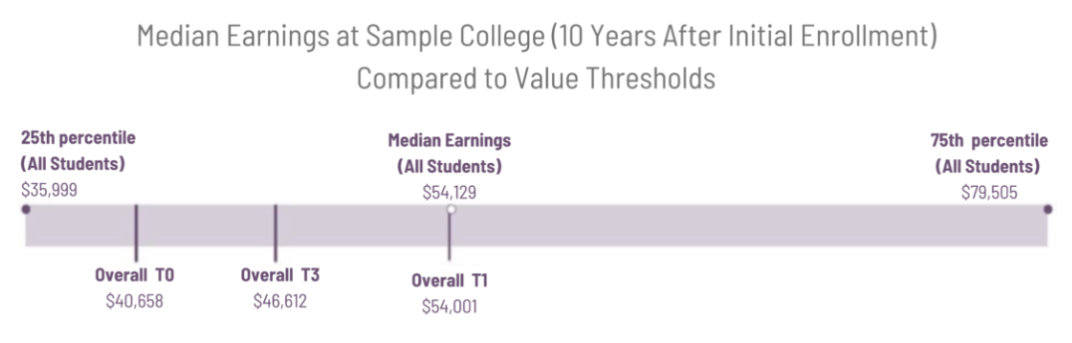
Equitable Value Explorer

Slide 8



Lighting Talks
Navi Dhaliwal
Economic Analyst
Research Institute at Dallas College
Angela Boatman
Associate Professor of Higher Education
Boston College
Sandra Barone
Senior Research Analyst
Trellis Strategies
September 18, 2024
Notes:
Now, we’ll hear lighting talks from three field-based researchers who used data from the Equitable Value Explorer, combined with data from other sources, to uncover fresh insights about economic returns in higher education. I’m delighted to introduce:
Navi
Angela
Sandra
Following these presentations, we’ll have a moderated discussion and we will leave time for a few questions from the audience. You can submit a question using the Q&A feature on Zoom at the bottom of the screen.

Slide 9


Equitable Value at Hispanic-Serving Institutions: National Trends with a Spotlight on Texas
Elevating Equitable Value Webinar
September 18, 2024

Slide 10
About the Report
Hispanic-Serving Institutions (HSIs) Nationwide
Hispanic Students in Texas
Dallas College
Goals
Understand the earnings outcomes of:
Students at HSIs nationwide
Hispanic students enrolled in Texas
Students at Dallas College
Methods
Descriptive analysis of data from the Equitable Value Explorer (EVE) and the Texas Education Research Center (ERC), using thresholds T0, T1, T2, and T3

Slide 11
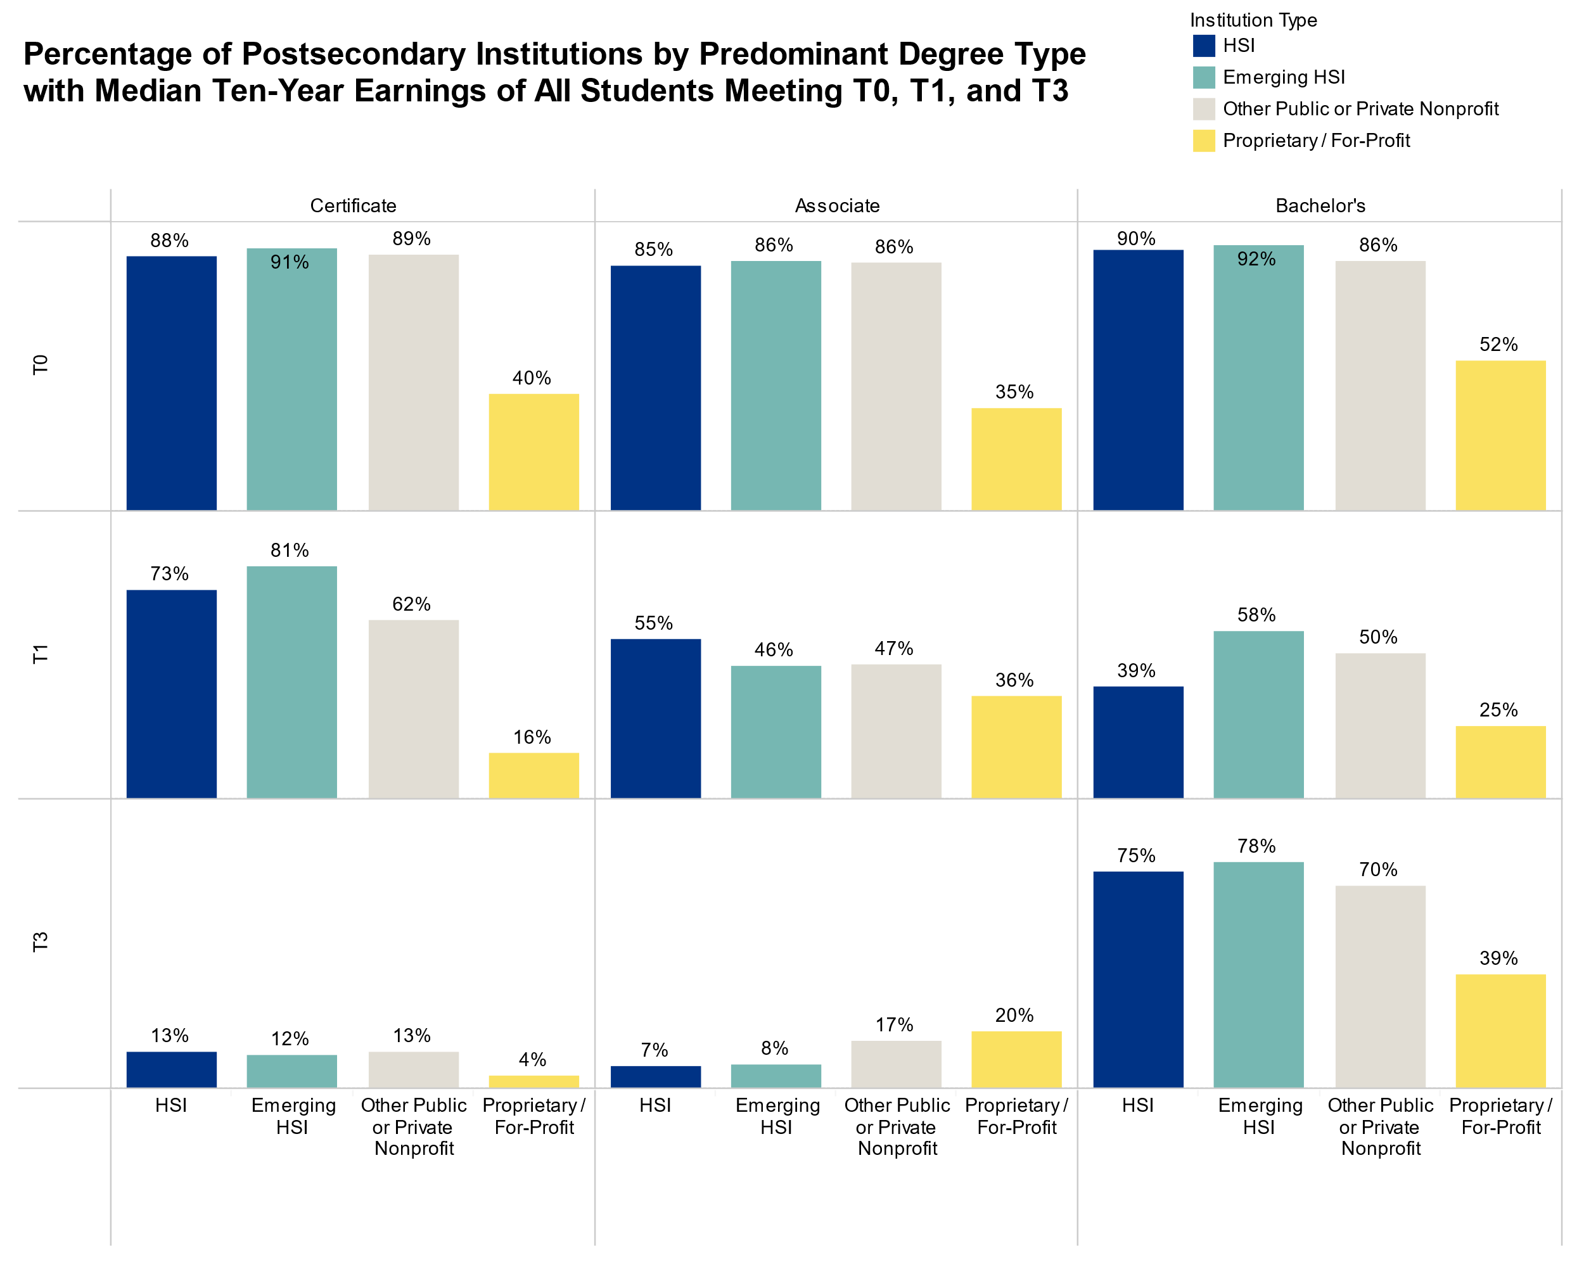

Slide 13
Exploring Economic Returns Across Rural-Serving Colleges
Shadman Islem
Angela Boatman
Boston College

Slide 14
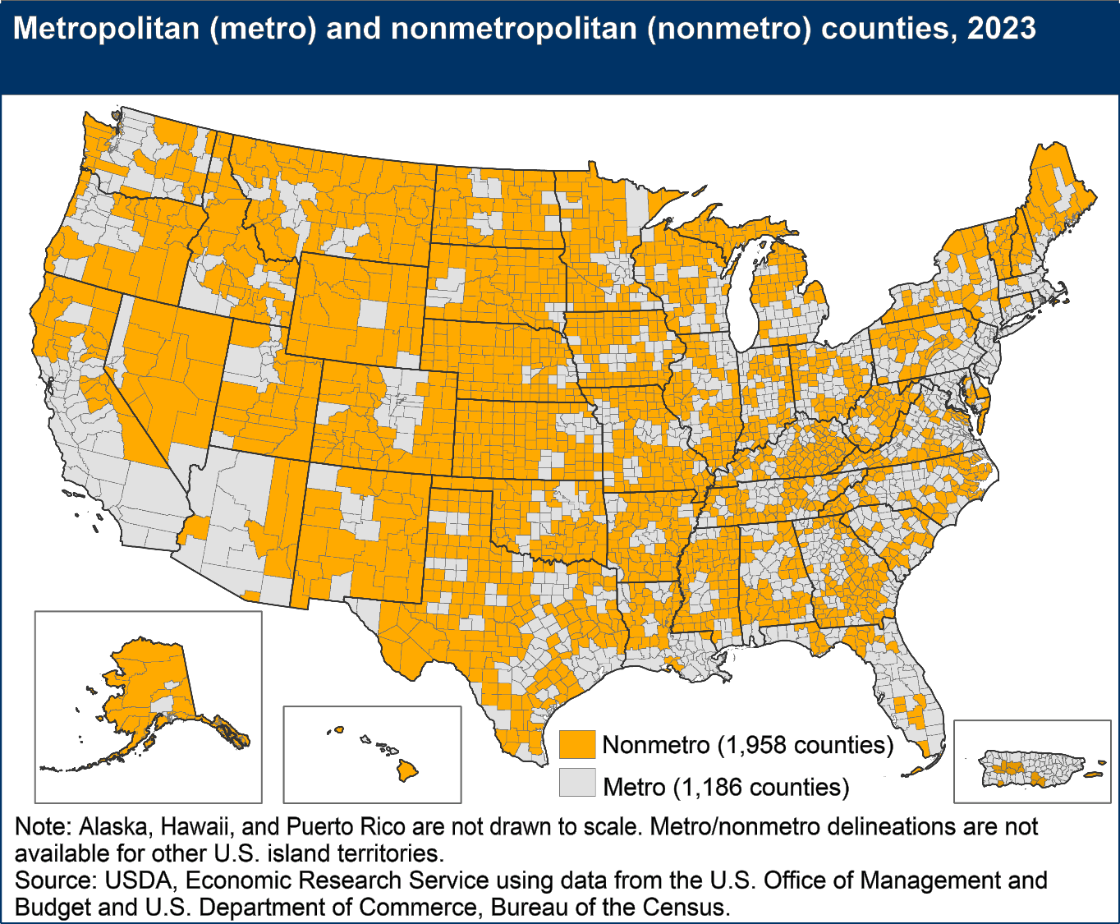
Rural Serving Institution (RSI) score: 0 -4 based on 5 factors (Koricich et al., 2021)
RSI: 1.175 - 2.14
High-RSI: 2.14 – 4
1,087 RSIs:
33% of all private, 4-year colleges
46% of all public, 4-year colleges
>50% of all public, 2-year colleges
~33% of HBCUs
~18% of HSIs
~93% of Tribal Colleges and Universities

Slide 15
Research Questions & Methods
1. Relationship between RSI score and earnings (negative binomial regression)
2. Relationship between RSI score and the EVE thresholds (logistic regression)
        T0: Minimum Economic Returns
T1: Earning Premium
T3: Economic Mobility
Covariates:
Institutional Sector, Completion Rate, Average Price, % Pell, Enrollment, % of student body by ethnicity, % of degrees awarded in STEM, county poverty status, county unemployment rate

Slide 16
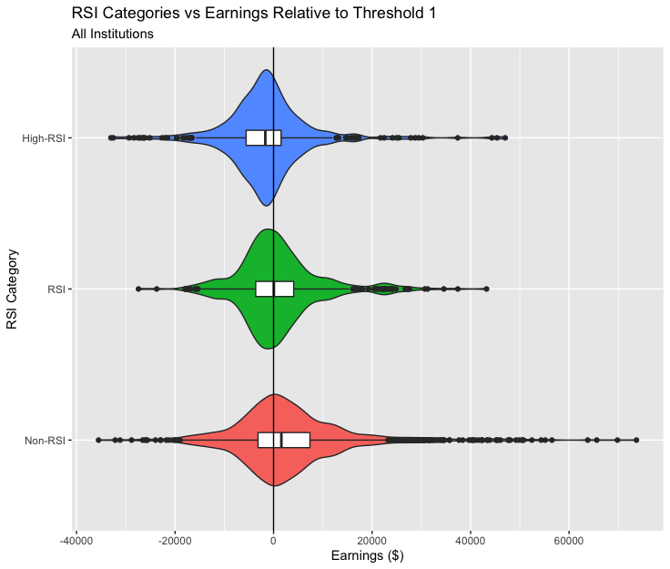
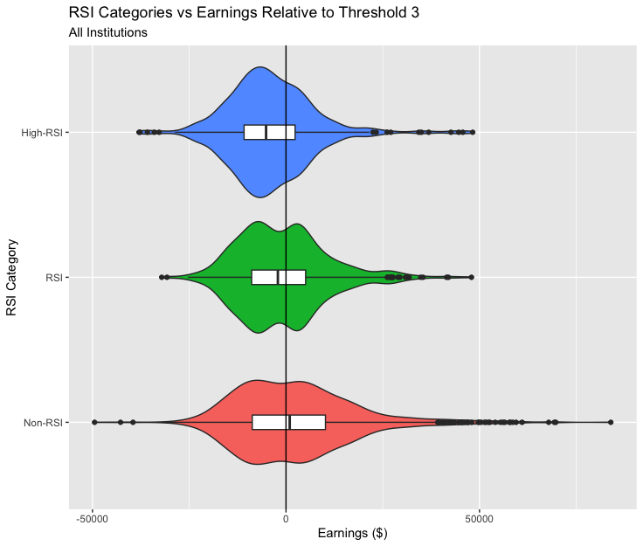
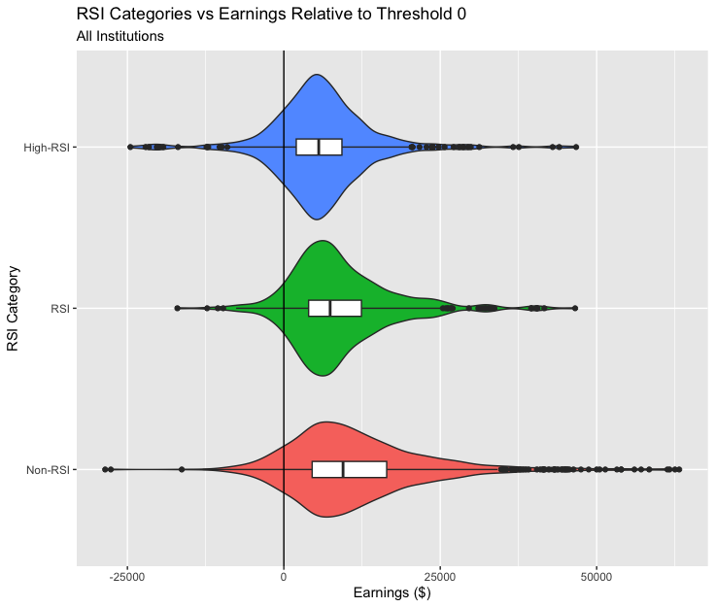
Median Earnings Relative the EVE Thresholds by RSI Category
Threshold 0
Threshold 1
Threshold 3

Slide 17
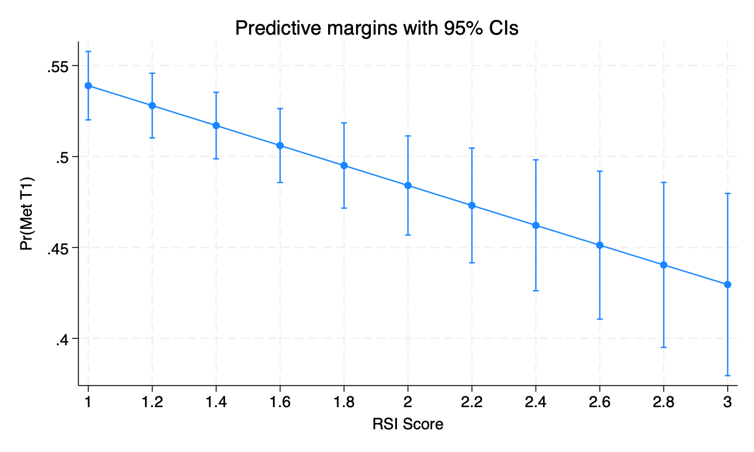
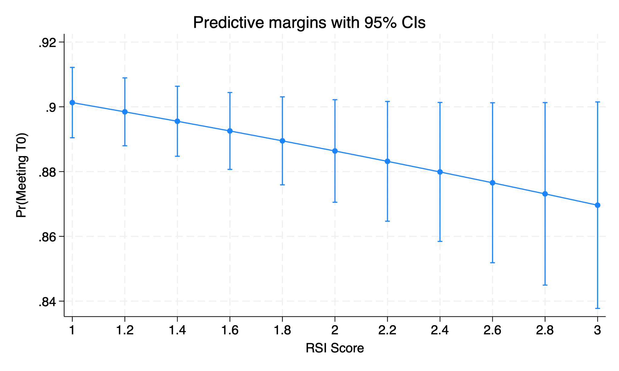
Results
Rural-servingness is a statistically significant negative predictor of earnings after controlling for institutional and county-level characteristics
          1 point increase in RSI score, expected earnings decrease by 1.9%
Meeting Threshold 0
Meeting Threshold 1

Slide 18
Just Out of Reach:
How Student Financial Well-Being Impacts the Realization of Economic Returns on Postsecondary Education
Elevating Equitable Value Webinar
September 18, 2024

Slide 19

Student Financial Wellness Survey (SFWS)
  OVERVIEW
  Self-reported, online survey that documents the financial well-being and student success indicators of postsecondary students.
  POPULATION
  Responses from nearly 200,000 students at 228 institutions in 33 states used for this study.

Slide 20
Factors of Student Financial Well-Being
 | Underlying Variables (SFWS Questions)
Factor 1: Financial Stability | Would you have trouble getting $500 in cash or credit in order to meet an unexpected need within the next month? Since January 1, 2022, approximately how many times did you run out of money? Since January 1, 2022, approximately how many times did you borrow money from your family and/or friends?
Factor 2: Financial Confidence | To what extent do you agree or disagree with the following statements? I worry about being able to pay my current monthly expenses. I worry about having enough money to pay for school. I know how I will pay for college next semester.
Factor 3: Financial Behaviors | To what extent do you agree or disagree with the following statements? I always pay my bills on time. I follow a weekly or monthly budget. I have the ability to manage my finances well.
Notes:
A subset of questions from the SFWS was used to develop three factors of student financial well-being:
Financial Stability – Is the student able to obtain money to cover unexpected expenses? Does the student regularly run out of money or borrow money from others?
Financial Confidence – Does the student worry about how they will pay their bills or pay for school? Do they know how they will continue to pay for school?
Financial Behaviors – Does the student pay their bills on time, follow a budget and believe that they have the ability to manage their finances well?
The factors were developed at the student level. After developing the factors at the individual level, students were ordered according to the factor score. Students in the bottom quartile for each factor are considered to have low financial well-being. Students were then aggregated at the institution level by calculating the percent of students at each institution with low financial stability, financial confidence, or financial behaviors.
If students were randomly distributed across institutions, all institutions would have 25% for each factor.

Slide 21
Analysis Sample
 | SFWS Subset | EVE Sample
Public Four-Year
Total number of institutions | 70 | 528
Percentage meeting or exceeding T0 | 91.4% | 97.0%
Median earnings relative to T0 for those meeting or exceeding T0 | $10,568 | $12,972
Private Nonprofit Four-Year
Total number of institutions | 32 | 993
Percentage meeting or exceeding T0 | 68.8% | 82.6%
Median earnings relative to T0 for those meeting or exceeding T0 | $10,864 | $11,703
Public Two-Year or Less
Total number of institutions | 121 | 988
Percentage meeting or exceeding T0 | 91.6% | 88.8%
Median earnings relative to T0 for those meeting or exceeding T0 | $5,244 | $5,863

Slide 22
OLS Regression Analysis
Dependent variable is the dollar amount by which median earnings at the school differs from the T0 threshold for the school.
Independent variable of interest is the percent of the school’s student body with low financial well-being.
Regressions were run separately for each factor (Financial Stability, Financial Confidence, and Financial Behaviors)
Control variables include: gender, race, age, enrollment intensity, and school type.

Slide 23
OLS Regression Results
Schools with higher proportions of students with low financial stability have lower expected median earnings.
This finding was consistent across all school sectors and all models tested.
This implies that the students who are most in need of moving up the economic ladder are at schools where that climb will be slower.

Slide 24
Moderated Discussion
Navi Dhaliwal
Economic Analyst
Research Institute at Dallas College
Angela Boatman
Associate Professor of Higher Education
Boston College
Sandra Barone
Senior Research Analyst
Trellis Strategies
September 18, 2024
Notes:
Now, we’ll hear lighting talks from three field-based researchers who used data from the Equitable Value Explorer, combined with data from other sources, to uncover fresh insights about economic returns in higher education. I’m delighted to introduce:
Navi
Angela
Sandra
Following these presentations, we’ll have a moderated discussion and we will leave time for a few questions from the audience. You can submit a question using the Q&A feature on Zoom at the bottom of the screen.

Slide 25

Questions?
September 18, 2024
Notes:
Questions from the audience

Slide 26
More to Explore…
Investigating Economic Outcomes of Postsecondary Education
Adjunct Labor and Inequality In Higher Education by Frederick Tucker of CUNY
Place Matters: Exploring Geographic Variation in Equitable Postsecondary Value Among U.S. Community Colleges by Roman Ruiz and Adam Hearn of the American Institutes for Research
Transforming at Scale: How AASCU’s Student Success Equity Intensive Promotes Equitable Postsecondary Value by Prateek Basavaraj & Morgan Taylor of the American Association of State Colleges and Universities (AASCU)
Assessing the Value of Post-Secondary Education in Michigan: An Equity-Focused Analysis by Monica Brockmeyer & Darryl Gardner of Wayne State University
September 18, 2024
Notes:
In addition to the three research papers you heard about today, there are four others in the Elevating Equitable Value research series to explore. These papers include:
Adjunct Labor and Inequality In Higher Education by Frederick Tucker of CUNY
Place Matters: Exploring Geographic Variation in Equitable Postsecondary Value Among U.S. Community Colleges by Roman Ruiz and Adam Hearn of the American Institutes for Research
Transforming at Scale: How AASCU’s Student Success Equity Intensive Promotes Equitable Postsecondary Value by Prateek Basavaraj & Morgan Taylor of the American Association of State Colleges and Universities (AASCU)
Assessing the Value of Post-Secondary Education in Michigan: An Equity-Focused Analysis by Monica Brockmeyer & Darryl Gardner of Wayne State University

Slide 27
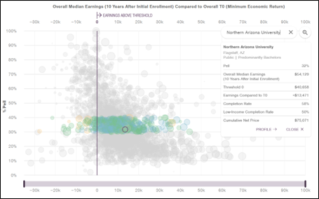

What’s Next?
How IHEP is advancing the Equitable Value Movement
Data from more states and institutions will be added to the Equitable Value Explorer.
Teams are putting the postsecondary value measurement framework into action to improve student and workforce outcomes.
September 18, 2024
Notes:
Data from more states will be added to the EVE.
IHEP also leads the VDC.
Analytic training for state agency state and institutional research teams
Original research related to postsecondary value using student level records to explore questions informed by participants priorities and strategic plans
Opportunity to publish data in the Equitable Value Explorer, at the University of Texas System has done

Slide 28
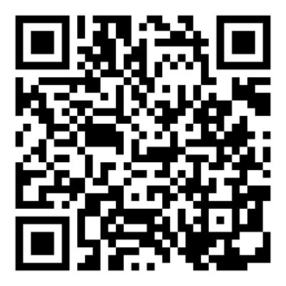
Thank You
Read the research:
ihep.org
Explore the data:
equity.postsecondaryvalue.org
Stay in touch:
Subscribe to IHEP’s newsletter

Slide 29



